Slide 1
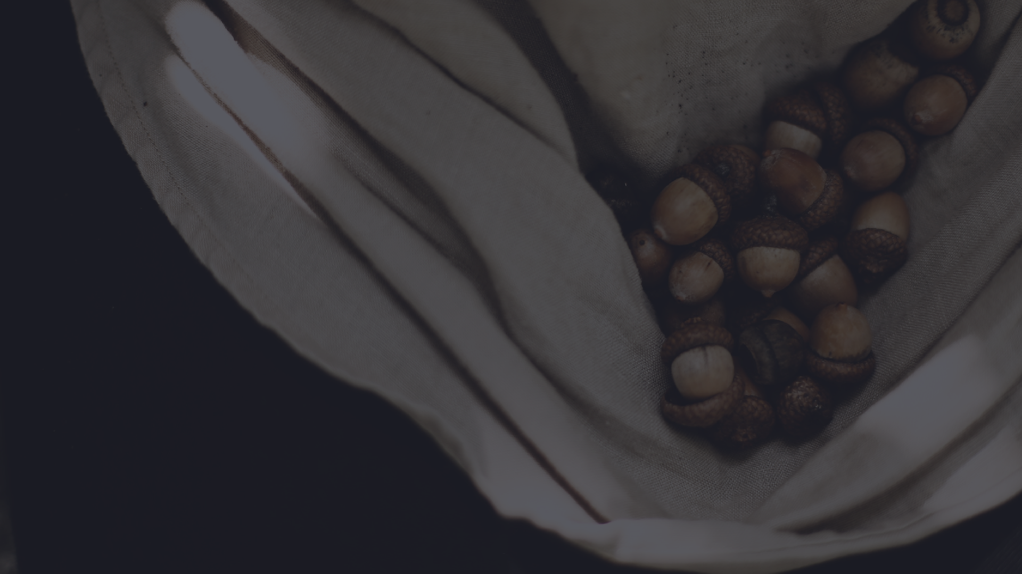
NALOXONE TRAINING
OVERDOSE PREVENTION AND SURVIVAL
Tribal Opioid Response

Slide 2
OUR CURRENT ONGOING PROJECTS
Traditions of Health aims to improve the integration of traditional healing and behavioral health into primary care
Tribal MAT aims to increase access to diverse services for patients who use opioids
White Bison Wellbriety Treatment Facility
Tribal Action Plan
Oneida Tribal Opioid Response Grant Initiatives

Slide 3
Training Overview
Harm Reduction
What is an opioid?
Recognizing an opioid overdose
Responding to an opioid overdose
Laws and procedures related to naloxone
Tips for preventing opioid overdose (optional)
Suggested resources for family and friends (optional)

Slide 4
HARM REDUCTION
A FRAMEWORK FOR SUPPORT
Harm reduction is a practical health approach that seeks to reduce negative consequences associated with drug use. Harm reduction falls in line with many of our traditions of community care. Harm reduction is a framework of care that incorporates safer use and social justice by choosing to acknowledge and minimize the harmful effects of drugs rather than ignore or condemn them. Harm reduction acknowledges people who use drugs as whole people, and calls for non-judgmental services and resources for people who use drugs and extended communities.
Inspired by Harm Reduction Coalition and First Nations Health Authority

Slide 5
HARM REDUCTION PRINCIPLES
PRACTICAL TOOLS
NON-JUDGEMENT
Shifting our approach to provide compassion instead of judgement, and challenging our own stigmas towards drug use and people who use drugs (PWUD)
MEET PEOPLE WHERE THEY'RE AT
Connect with family/friends/patients in a way that is effective for them, and guided by their wants and needs
"ANY POSITIVE CHANGE"
People will not necessarily want to be abstinent, but supporting with any positive change -- such as decreasing use, safer use, or utilizing MAT options -- is valuable!
"CHAOTIC USE"
Understand that many people use drugs safely and in a way that works for them. Recognize that drug use is problematic when it becomes chaotic to the person

Slide 6
What are opioids?
An opioid is any drug that contains opium (or its derivative).
Opioids can be:
Natural or synthetic.
Prescription medications or illegal drugs.
Pills, capsules, powder, dermal patches, or liquid.
Swallowed, smoked, snorted, or injected.
Examples of opioids: heroin, fentanyl, morphine, percocet; and street names for different opioids such as tar, percs, lean, fent, H, smack
WHAT ISN'T AN OPIOID?
Everything else. Methamphetamines, ecstasy, LSD, cocaine, ketamine, xanax, and many other drugs are not opioids, though they may be mistaken as them.

Slide 7
About Opioids
Opioids:
Manage pain, suppress coughs, and treat opioid use disorder (addictions).
Cause feelings of euphoria, contentment, and/or detachment.
Have effects lasting from 3 to 24 hours.
In excessive amounts, opioids can suppress a person’s ability to breathe.

Slide 8
How Opioids Work
OPIOID RECEPTORS
Opioids bind to and activate receptors in the brain, triggering the release of dopamine – a neurotransmitter linked to learning, pleasure, and reward.
Opioid
Opioid fits exactly on receptor
Opioid receptor in brain
Overtime, opioid use changes both the amount and sensitivity of dopamine receptors causing users to need a continuous supply of opioids to feel “normal.”

Slide 9
Examples of Prescription Opioids
Generic Name | Brand Name
Oxycodone | Oxycontin®, Percocet®, Roxicodone®
Oxymorphone | Opana®
Hydrocodone | Vicodin®, Lorcet®, Zohydro®, Zortab®
Hydromorphone | Dilaudid®
Morphine
Meperidene | Demerol®
Codeine | Tylenol® 3 & 4
Buprenorphine | Suboxone®, Subutex®, Zubsolv®
Methadone
Fentanyl | Duragesic®

Slide 10
Examples of Illicit Opioids
TYPES OF DRUGS
Heroin
Non-pharmaceutical fentanyl (Illicitly produced, synthetic drug)
Pill form packaged to look like prescription medications
Powder form looks similar to heroin
May be hundreds of times more potent than heroin
Fentanyl can be extremely deadly!
Depressants
OPIOIDS
H e r o i n F e n t a n y l M o r p h i n e
M e t h a d o n e P e r c o c e t C o d e i n e
BENZODIAZAPINES
Valium Xanax Ativan Clonazepam SEDATIVE HYPNOTICS
A m b i e n G H B
A L C O H O L
B e e r W i n e S p i r i t s
Cocaine
Methamphetamines Adderall
Ritalin Caffeine
L S D
M u s h r o o m s P C P
M a r i j u a n a M D M A
Stimulants
Hallucinogens
WHAT ISN'T AN OPIOID?
Everything else. Methamphetamines, ecstasy, LSD, cocaine, ketamine, xanax, and many other drugs are not opioids, though they may be mistaken as them.

Slide 11
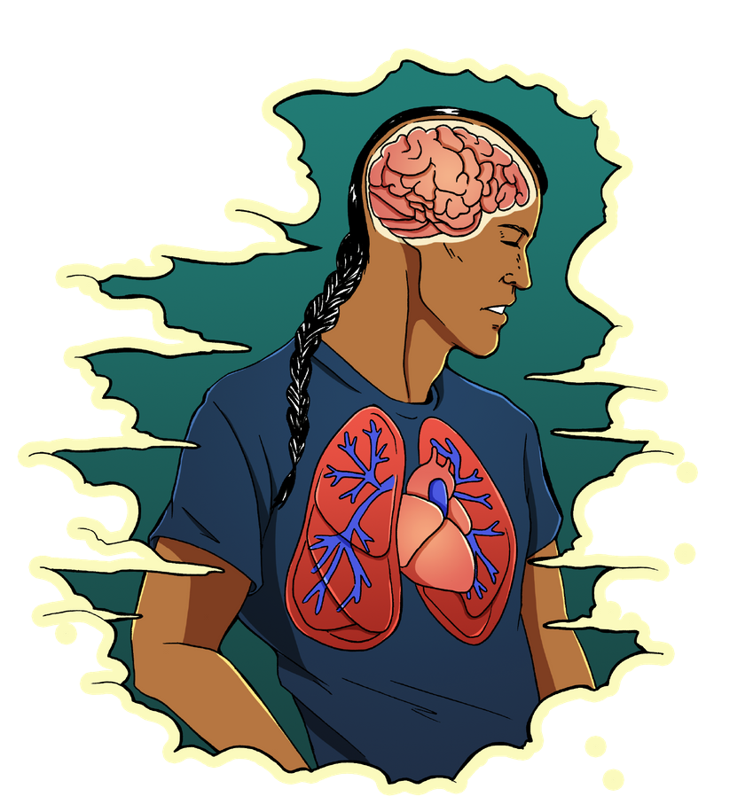
HOW OVERDOSE & REVERSAL WORKS
OPIOID OVERDOSE NALOXONE EFFECTS
Opioids fill receptors
Fast-acting but short-lived
Activate systems that control breathing
Displaces opioids in brain
Blocks opioids from filling receptors
Respiratory depression
No oxygen to brain, life-threatening
Effects of overdose reversed, and life is saved!

Slide 12
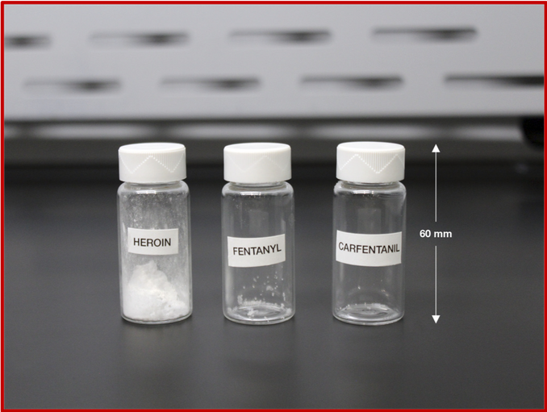
ALL ABOUT FENTANYL
What is Fentanyl?
Fentanyl is a synthetic opioid and prescription medication
In recent years, it has become common as a drug of choice
Can Be Used Safely
With the right overdose prevention tools, fentanyl can and is often used safely!
Can Be In Other Drugs
Fentanyl is often found in street supplies of heroin in many cities, and can be found in trace amounts in other drug supplies as well
More Potent
Compared to heroin, fentanyl is 50-100 times more potent as an opioid
This increases the margin of error involved for overdose

Slide 13
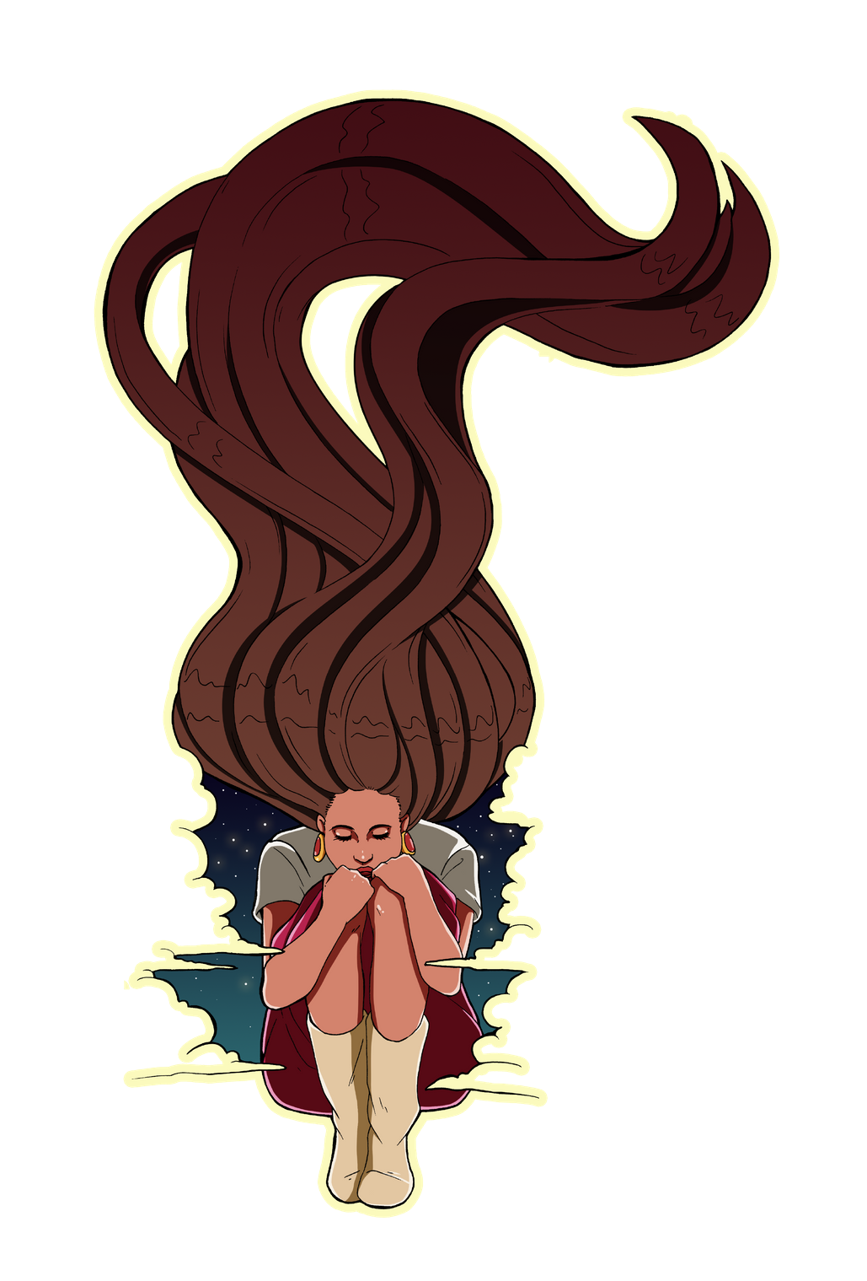
OVERDOSE RISK FACTORS
USING FAST
Using a lot at once, like doing a full shot of heroin at one time
MIXING MULTIPLE
Mixing multiple types or categories of drugs, like opioids and stimulants at the same time
FORGETTING SELF CARE
Not drinking water or eating regularly, sleeping enough, or being aware of illness
TOLERANCE CHANGES
Using the same amount after taking a break, like after hospitalization, jail, or detox
BEING UNPREPARED
Not having naloxone or knowing how to use it, or using with people who don't!
BEING ALONE
Using alone, or without anyone knowing to do a "wellness check"

Slide 14
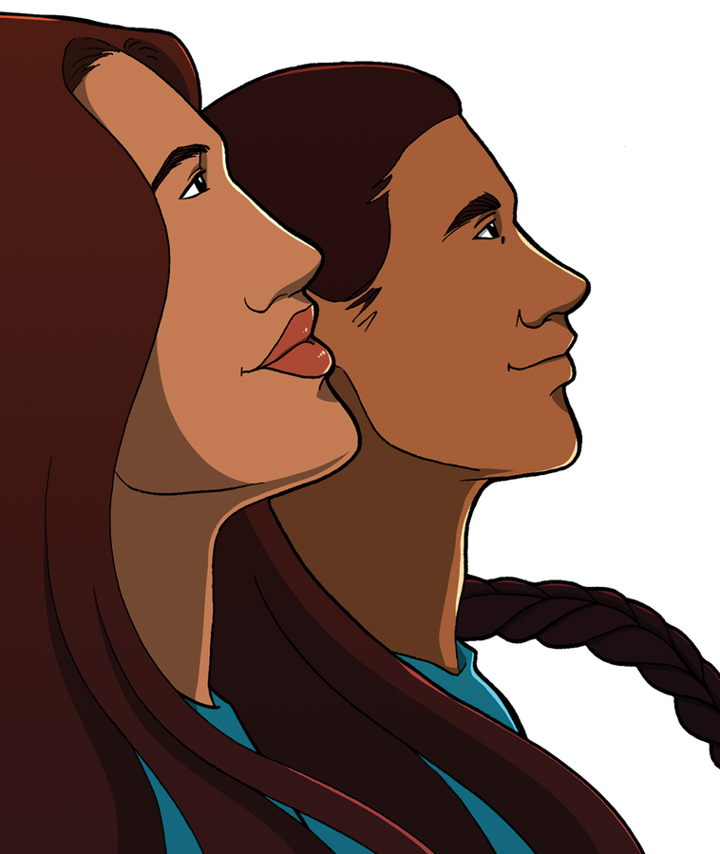
OVERDOSE PREVENTION TIPS
USING SLOW
Going slowly, and testing with a small amount before a full dose
AVOID MIXING
Avoiding mixing if possible, especially depressants with other depressants, or with stimulants!
HEALTHIER THE BETTER
Eat well, stay hydrated, sleep well, and avoid illness
ADJUST FOR TOLERANCE
Use less than usual after a break from regular use
BE READY, STAY READY
Always have naloxone and an overdose plan. Being prepared means being safe!
FRIENDS MAKE THINGS BETTER
Use with trusted friends, and stagger use with each other

Slide 15
What is an opioid overdose?
An opioid overdose happens when a toxic amount of an opioid – alone, or mixed with other drugs, and/or substances – overwhelms the body’s ability to handle it.
Many opioid‐related overdoses result from mixing prescription painkillers or heroin with benzodiazepines (benzos), cocaine, and/or alcohol.

Slide 16
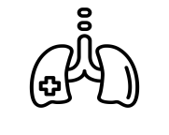
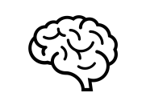
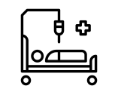
Overdose Impacts on the Body
Respiratory failure
Vital organs fail (heart, brain)
Unconsciousness, coma, death
Lack of oxygen in the blood

Slide 17
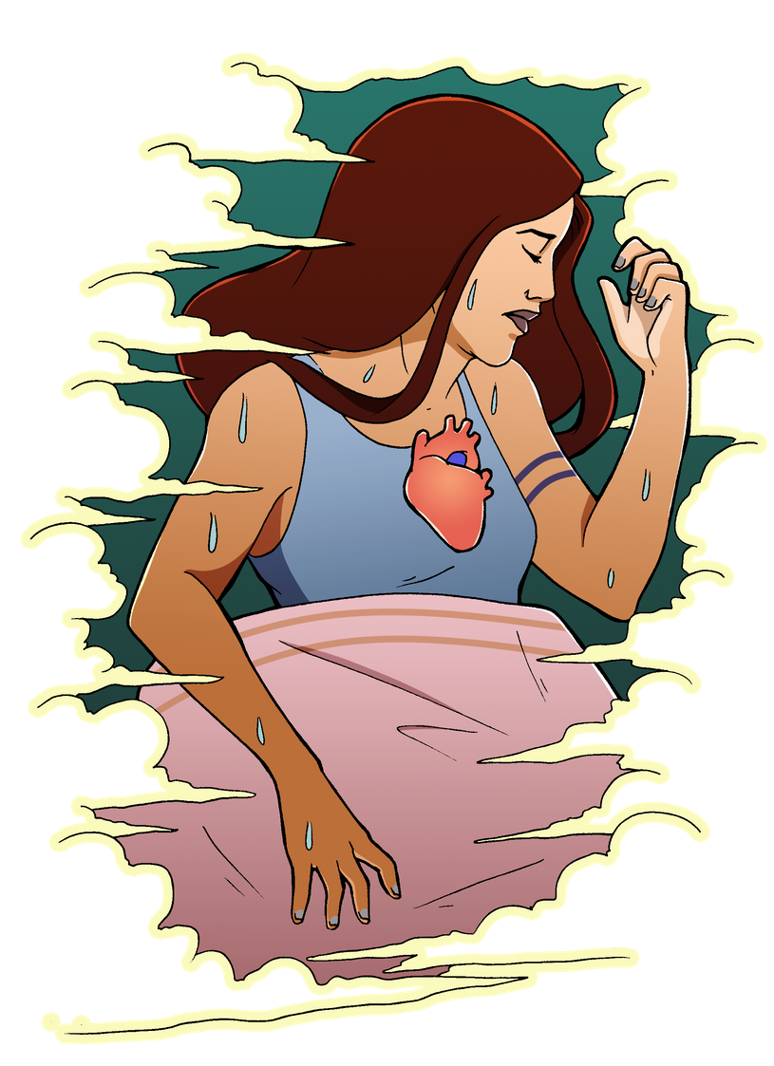
RECOGNIZING
OPIOID
Slow, shallow, irregular breathing, or none at all
Unresponsive/unconscious
Deep snoring, gurgling, and/or choking noises
Blue or ashen/gray lips and fingertips
Pale, cold, clammy, and/or sweaty skin
Pulse slow or erratic
OVERDOSE
Notes:
Time is very important when an unconscious person is not breathing. Permanent brain damage begins after only 4 minutes without oxygen, and death can occur as soon as 4 to 6 minutes later.
Not all of these symptoms may be present at the time of life-threatening overdose. Focus on looking for low, shallow, or no breathing.
Note that these symptoms could also be present in a patient suffering from cardiopulmonary arrest from another condition. Severe hypoglycemia or a heart attack may also present similarly. This is one reason why it is important to call emergency medical services immediately when these symptoms are present. Naloxone will not help a person experiencing these symptoms for a medical condition other than an opioid overdose.

Slide 18
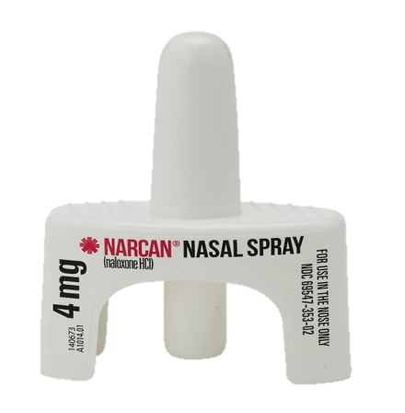
What is Naloxone ?
Naloxone is a medicine that reverses opioid overdose by restoring breathing.
Notes:
It is important to stress these points as they address some of the most common misconceptions about naloxone.

Slide 19
About Naloxone
Delivery: intramuscular, intranasal, or intravenous
Wears off in 30‐90 minutes
SAFE for children, pregnant women, and pets
NO significant side effects
NO potential for misuse or getting high
Only effective in reversing opioid overdoses
No effect on someone who hasn’t taken opioids

Slide 20
How does Naloxone work?
The brain has many receptors for opioids. When too much of an opioid fits on too many receptors, an overdose occurs.
Naloxone knocks opioids off opioid receptors and binds to receptors for a short time. This blocks the opioids’ effects, quickly restoring breathing.
Naloxone
Opioid
Naloxone
Opioid receptor in brain
Notes:
Here’s an example of how naloxone works in the brain to block opioids and reverse the effects of an overdose.
Everyone has used magnets on their refrigerators. You basically have two types of magnets: the free, advertising magnet from your local realtor or pizza shop which doesn’t hold anything up on the fridge, and the really strong magnets you can hang your kids’ art projects from. Opioids are like the pizza magnet. They attached to the receptors in the brain, but the attachment is not that strong. Naloxone is an industrial strength magnet. It comes into the brain, kicks the opioids off the receptors, and then blocks the receptor. The opioids are still in the brain, but because the receptors they attach to are being blocked by the naloxone, they just float around. Naloxone wears off sooner than the opioids however, which means the opioids can reattach and someone can go back into an overdose. This is why calling 911 is so important.
The effectiveness of naloxone is also impacted by the amount and potency of drugs already in the system. More opioids in the system means more opioid receptors are blocked, making more naloxone necessary to “clear” the receptor.

Slide 21
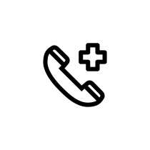
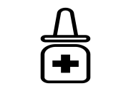
Responding to an Opioid Overdose
Shake and wake
Call 911
Give naloxone
Rescue breathing/recovery position
Care for the person
Notes:
Instructions for responding to an overdose are presented in this section in order for the purposes of training. However, these steps can be occur simultaneously, especially if there is more than one person on scene.
If some one is not breathing it is important to give them rescue breaths and chest compressions, as just four minutes without air can cause brain damage. In fact, the American Heart Association recommends providing rescue breathing before administering naloxone. If a person is trained in CPR, then CPR should be administered (chest compressions and rescue breathing) However, not everyone is comfortable giving rescue breaths or has CPR training. This is why calling 911 is so important.
At a minimum, if you suspect someone is overdosing, it is your ethical responsibility to call 911.
A Good response to an overdose is to call 911 to ensure proper medical attention is provided and administer naloxone.
A Better response to an overdose is to call 911, administer naloxone, and provide chest compressions.
The Best response to an overdose is to call 911, administer naloxone, and administer rescue breathing and/or CPR.

Slide 22
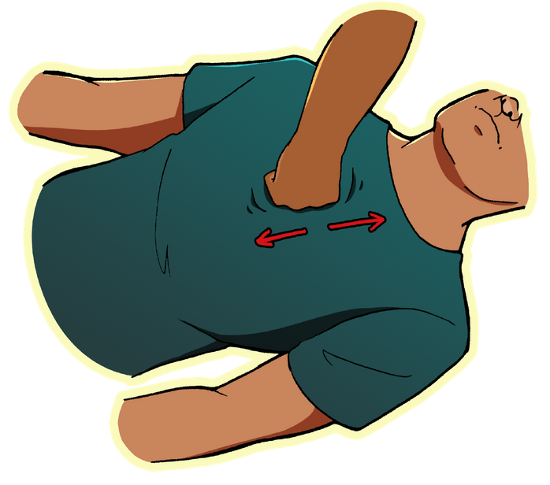
1. STIMULATE
Verbal Stimulation
Call their name
Say "If you don't wake up, I'm going to 'narcan' you"
Physical Stimulation
Give a sternum rub Pinch the back of their arm
Notes:
Some people use the term “Shake and Wake” others say “Rouse and Stimulate” – Shake and wake focuses on making a loud noise and shaking the person to elicit a response; rouse and stimulate encourages performing a chest rub if you get no response to the noise /shaking stimuli. The purpose is to ensure the person is in fact in medical distress.

Slide 23
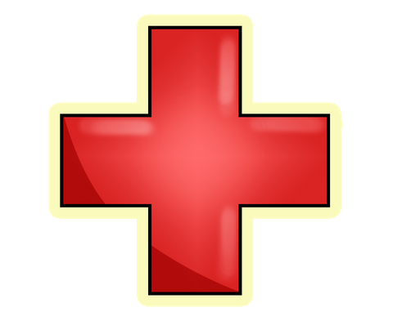
2. CALL 911
Calling for Help is Critical
They may be experiencing another health emergency
While one person administers narcan and provides rescue breaths, another calls 911
Naloxone is temporary
911 Script
Tell 911 operator
Where you are
What you observed Ex. Person is turning blue, won’t wake up
Tell emergency responder onsite:
Drugs/substances the person used
Naloxone administered ie how much and when
Notes:
Calling 911 is especially important with the rise in fentanyl. As was mentioned, it is extremely potent and as a result, it may take several doses of naloxone in order to reverse the overdose effects.
Naloxone is only temporary; it is like pushing the pause button on a remote control. It will eventually wear off, and if there are still large amounts of opioids in the system, the person can fall back into an overdose.
The 911 dispatcher can also talk you through caring for the patient including providing rescue breaths and administering naloxone (if available) until EMS arrives.

Slide 24
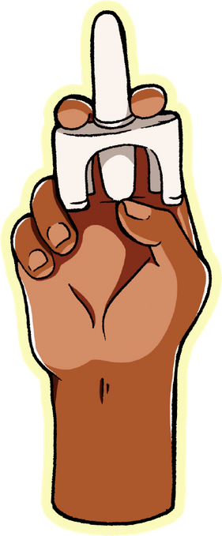
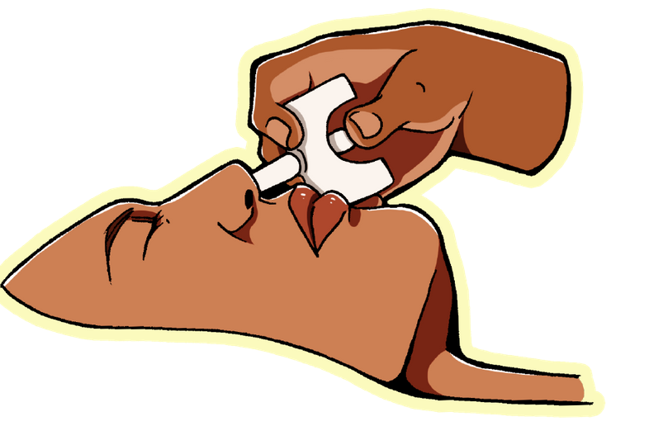
3. ADMINISTER NALOXONE
DO NOT TEST SPRAY DEVICE!
Peel back the package and remove device
Hold device with thumb on bottom of plunger, and one finger on both sides of nozzle
Place and hold tip of nozzle in either nostril until fingers touch bottom of person's nose
Press the plunger firmly to release the dose
Give another dose after 3 minutes if there is no sign of them breathing on their own

Slide 25
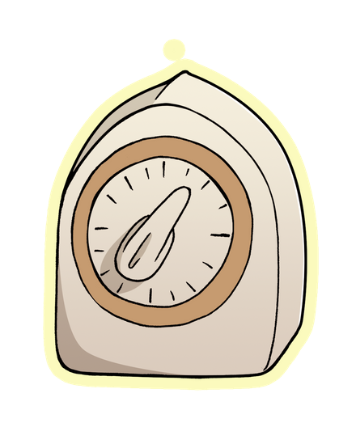
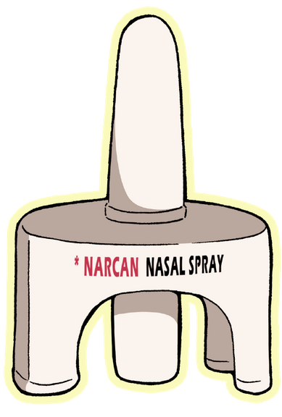
It's Fast Acting
Give one dose, then wait 3 minutes to see if they need more
If no signs of them being able to breath on their own or becoming responsive, administer another dose
MORE ABOUT NALOXONE
Continue to give naloxone at 3 minute intervals until they show signs of responsiveness
It's Short Lived
After 30-90 minutes, naloxone will wear off
Naloxone is only a temporary opioid blocker A person can slip back into overdose, especially if they used more opioids in the 30-90 minute period
*Naloxone CAN be used for pregnant people!

Slide 26
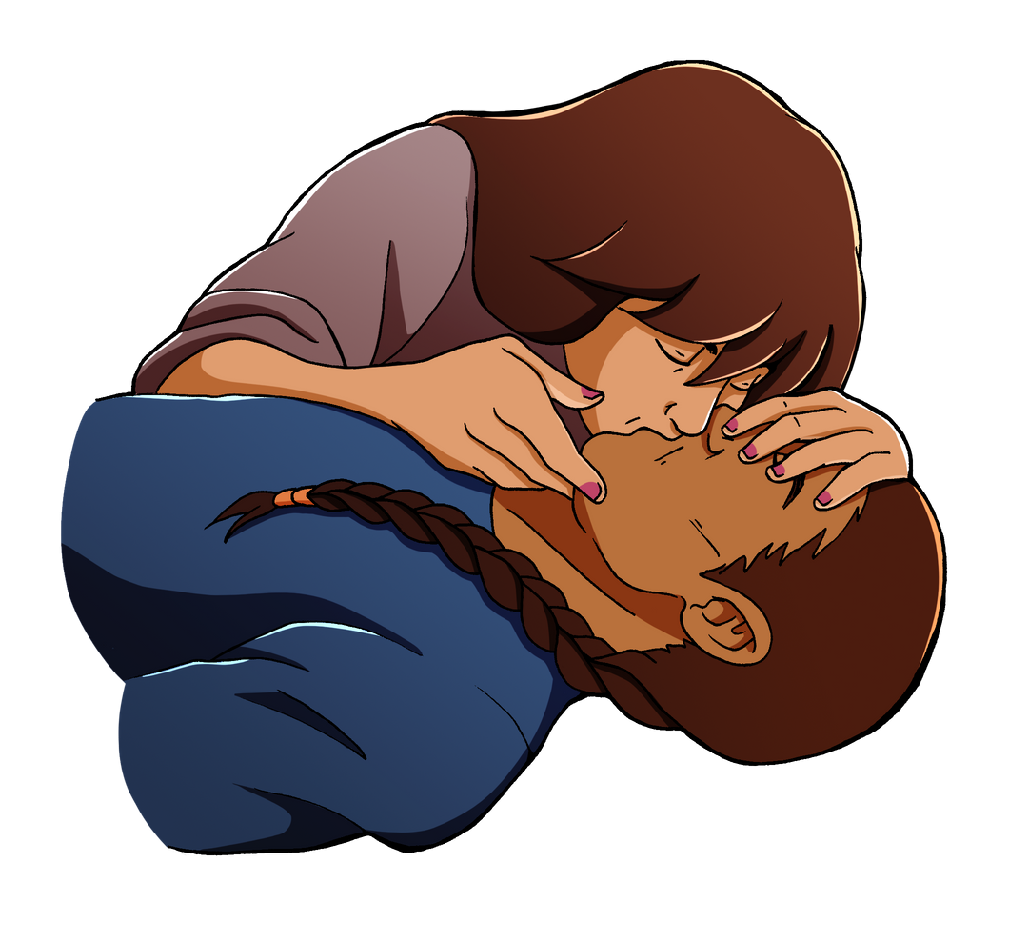
4. RESCUE BREATHING
While waiting for naloxone to work, begin giving rescue breaths
Clear Airway
Check and clear their airway
Rescue Breathing
Lay person flat on their back
Tilt their head back
Pinch their nostrils
Create a seal around their mouth with yours
Give two quick breaths, then another every 5 seconds
Without oxygen, brain damage can occur within minutes. Continue rescue breaths, even after giving a second dose or more of naloxone, until they breathe on their own
Notes:
Slow breathing for an adult is approximately less than one breath every five seconds.
The most common item found in an overdose patient’s mouth is the cap from the needle they used to inject themselves.
Administering rescue breathes for an extended period of time can induce vomiting due to air getting into the stomach. If this happens, make sure to check the airway again for anything that may be blocking it before continuing with rescue breaths.

Slide 27
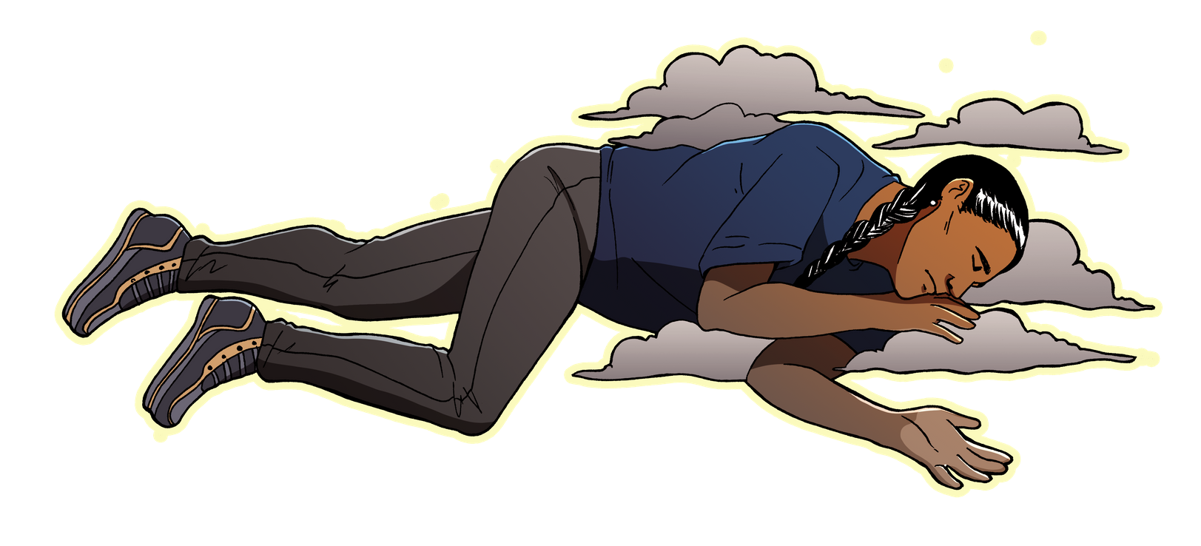
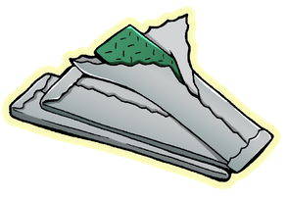
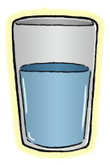
5. OVERDOSE AFTERCARE
Recovery Position
At first sign of them breathing normally on their own, put them in recovery position
On side, hand supporting head, with one leg bent for stability
Wait with Them
When person becomes conscious, let them know what happened and tell them if an ambulance was called
Ask if you can wait with them and make sure they're safe when naloxone wears off
Gentle Support
Understand that they will likely be in withdrawal and feeling terribly sick
Remind them not to use again until naloxone wears off
Offer what you can to make them as comfortable as possible while they wait for naloxone to wear off
Notes:
The effects of naloxone are temporary. If a person has consumed a large amount of opioids, or if the opioids included fentanyl, overdose symptoms may return even after administering naloxone. This is one reason it is so important to call 911 for further medical assistance.
A person who has overdosed should be monitored for at least 2 hours, or more to ensure overdose symptoms do not return.
Some individuals may be combative or agitated when revived. This is more common with intramuscular, or high dose naloxone administration (most commonly administered by EMS), and less common with nasal naloxone.

Slide 28
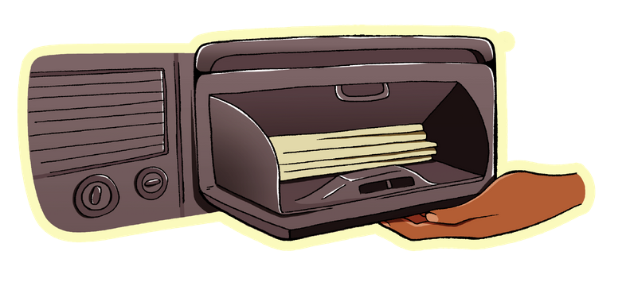
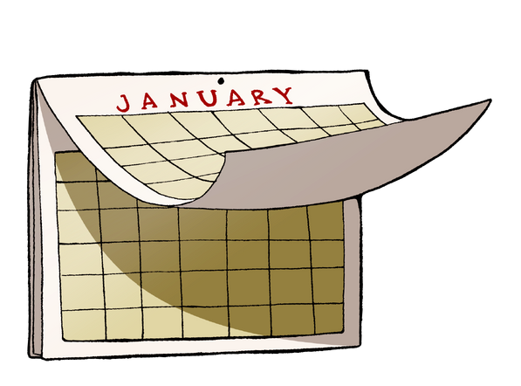
CARING FOR YOUR NALOXONE
x
STORAGE
Store naloxone in a safe and quickly accessible place. Keep it at room temperature and protected from direct sunlight. Never store in fridge or car!
EXPIRATION
Be mindful of expiration dates and get new naloxone when it expires. However, keep expired kits in case you need extra doses in the future.
Expired naloxone is slightly less potent but poses no risk of harm.
Notes:
Do not allow naloxone to freeze or attempt to use if it does freeze. If the naloxone is cloudy, it may be an indication that it is no longer usable.
Keep naloxone in a safe place away from children and pets, but easy to access in case of emergency.

Slide 29
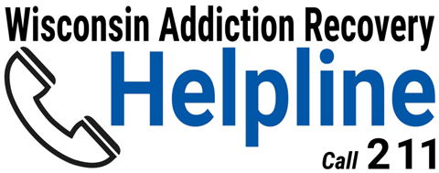
Help is Available
Wisconsin Addiction Recovery Helpline
Call: 211
Visit: addictionhelpwi.org
Notes:
When some one overdoses, they may be more willing to seek help. This may be a good opportunity to share resources about treatment options. Know what resources are available locally.

Slide 30
WHERE TO GET NALOXONE
Vivent Health - Green Bay445 S. Adams St.
Oneida Nation 2640 West Point Rd.
NEW Hope Coalition 1701 Dousman Street
DarJune Foundation, Inc.1018 Shawano Ave
Oneida Health Center Pharmacy 525 Airport Drive Oneida Costco Pharmacy #11622355 COSTCO WAY BELLEVUE
Walmart Supercenter #50901415 LAWRENCE DR DE PERE Walmart Supercenter #19082292 MAIN ST
Walmart Supercenter #14532440 W MASON ST
Sam's Club #81492470 W MASON ST
Walgreens #6569464 CARDINAL LN
Walgreens #57461995 MAIN STREET
Walgreens #32532204 UNIVERSITY AVE
Walgreens #31332301 S ONEIDA
Walgreens #31151165 W MASON STREET
Walgreens #30881401 EAST MASON
Walgreens #21182500 E WALNUT ST
Walgreens #15637150 S WISCONSIN ST
Walgreens #115761979 LIME KILN RD
Walgreens #11339116 N MILITARY AVE
Walgreens #10235901 MAIN AVE
Pick 'n Save #1861819 MAIN STREET
Pick 'n Save #1071291 LOMBARDI ACCESS RD

Slide 31
Carrying Naloxone
State laws allow the use and administration of naloxone by anyone.
Administer naloxone in accordance with training procedures.
Make a good faith effort to get emergency medical help for a person experiencing an opioid overdose.
Notes:
State law allows you to carry naloxone and administer it. Similar to how you cannot be held liable for cracking someone’s ribs when administering CPR, you cannot be held liable for a good faith attempt to help someone by administering naloxone.
State Statute 450.11 Prescription drugs & Devices:
(1i) Opioid antagonists
(b) Possession, dispensing, and delivery
450.11(1i)(b)1.1 Any person may possess an opioid antagonist
450.11(1i)(b)2.a.a. Subject to subd. 2.b-d: any person may deliver or dispense an opioid antagonist.

Slide 32
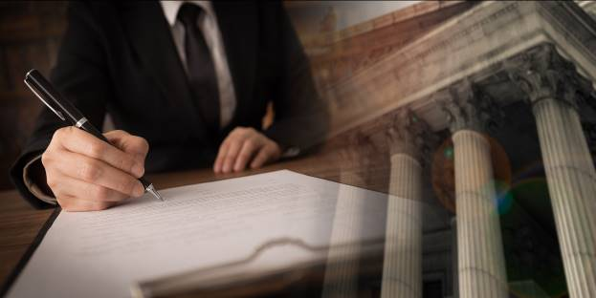
Good Samaritan Laws in Wisconsin
Good Samaritan laws are meant to encourage people to:
Call 911 for help when someone overdoses.
Administer naloxone as soon as possible.
Notes:
Just because the law is written with the intent to create limited immunity in certain situations, people may still be sued and therefore incur fees and expenses.
Please make sure to consult your own legal counsel for a more complete understanding of the law and how it may be applied to individual circumstances.

Slide 33
Good Samaritan Laws in Wisconsin
2013 Wisconsin acts 194 and 200 enacted the following:
A person who helps someone who is overdosing is immune from criminal prosecution for:
Possession of a controlled substance.
Possession or use of drug paraphernalia.
Calling 911 in an overdose situation will not affect parole or probation status.
See: §961.573, §961.41(3g), §441.18(3) and 448.037(3)
Notes:
450.11(1i)(c)2. 2. Subject to par. (a) 2. and ss. 441.18 (3) and 448.037 (3), any person who, acting in good faith, delivers or dispenses an opioid antagonist to another person shall be immune from civil or criminal liability for any outcomes resulting from delivering or dispensing the opioid antagonist.
Under current law, an aider is a person who summons or provides emergency medical assistance to another person because the aider believes the other person is suffering from an overdose or other adverse reaction to a controlled substance or controlled substance analog. Current law also grants limited immunity from prosecution for possessing a controlled substance or controlled substance analog to the aided person in this circumstance provided that the aided person completes a drug treatment program.
The current law provisions relating to revocation of probation, parole, or extended supervision and to aided persons sunset on August 1, 2020. At this time, the law no longer provides immunity from revocation of probation, parole or extended supervision for the possession of a controlled substance in the case of requesting assistance in an overdose situation.

Slide 34
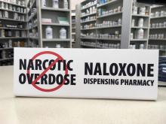
Standing Order for Naloxone
The Wisconsin standing order for naloxone allows pharmacies to dispense naloxone to individuals without a prescription.
For more information on the standing order or to find a participating pharmacy, visit:
https://www.dhs.wisconsin.gov/opioids/standing-order.htm
Notes:
Naloxone is not provided for free under the standing order. Pharmacies sell it. They do not giveaway.

Slide 35
Activity
Brainstorm overdose prevention tips
Notes:
Have participants brainstorm up to three ideas for preventing an overdose. Have them write their ideas on separate sticky notes and place them on a white board or 3M paper. Read them and discuss.
Alternatively, have participants verbally share their thoughts on how to prevent an overdose and write the idea down on 3M paper.

Slide 36
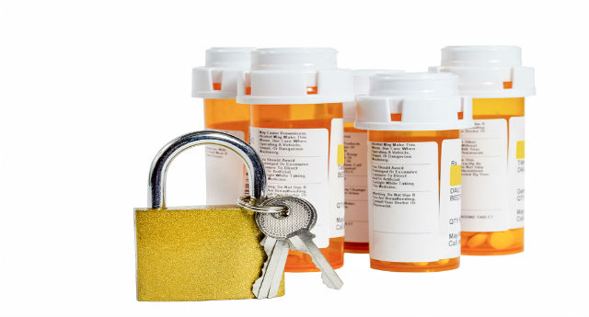
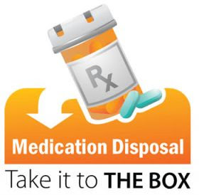
Opioid Overdose Prevention Tips
Keep medicine in a safe place, like a locked cabinet. (Naloxone should be kept readily available).
Properly dispose of expired or unwanted medications.
Only take medicine prescribed for you.
Take medicine only as directed.

Slide 37
Opioid Overdose Prevention Tips
Opioid Overdose Prevention Tips
Do not share prescription drugs with others.
Check with your doctor before taking opioids if you have breathing problems (like asthma or sleep apnea).
Do not mix pain medication with other drugs, including alcohol.

Slide 38
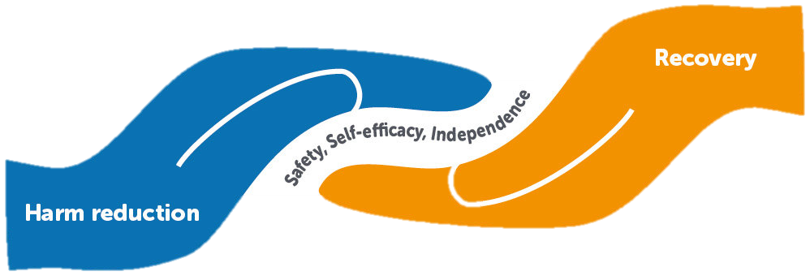
Opioid Overdose Prevention Tips
Opioid Overdose Prevention Tips
Do not use opioids alone.
Make an overdose prevention plan. Share it with someone you trust to give you naloxone if needed.
Start slow, know your dose.
Notes:
You cannot respond to your own overdose! Make sure that if you are using opioids you have a plan and DO NOT use alone.

Slide 39
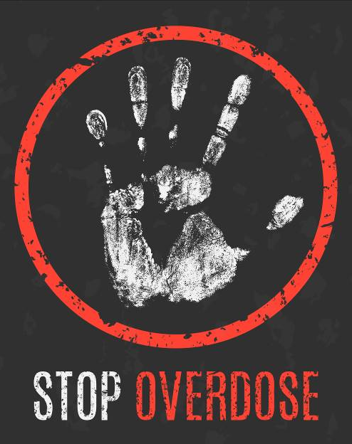
Opioid Overdose Prevention Tips
If you have not used opioids in a few days, your tolerance will be lower and your risk for overdose greater. Use fewer opioids than you normally would.
Always keep naloxone on hand. Tell others where it is.

Slide 40
Impact of Anecdotal Overdose Remedies
While well‐intentioned, these methods waste valuable time
Anecdotal Remedy | Possible Consequence
Use ice to cool down body | Slowed heart rate, abnormal heart rate
Put person in bath or shower | Drowning
Hit, slap, or burn fingers or feet | Bruising, broken bones, infection, amputation
Give drink or induce vomiting | Choking
Inject person with cocaine, salt water, milk, or epinephrine | High blood pressure, infection
Notes:
While well‐intentioned, these methods waste valuable time that would be better spent on rescue breathing, administering naloxone, and calling 911.

Slide 41
QUESTIONS?
Tribal Opioid Response

Slide 42
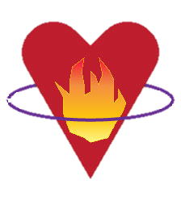
Contact
Jacqueline Ninham
jninham3@oneidanation.org
Leslie Doxtater
ldoxtat1@oneidanation.org
920.490.3916
Tribal Opioid Response
Notes:
When training others add your own contact information.

